Slide 1

Introduction to Freelancing with MERN Stack
In today's rapidly evolving digital landscape, freelancing has emerged as a promising career path, offering flexibility, independence, and the opportunity to showcase your skills on a global stage. The MERN stack - a powerful combination of MongoDB, Express.js, React.js, and Node.js - has become a go-to choice for building robust, scalable, and user-friendly freelance applications. This introduction will guide you through the exciting world of freelancing with the MERN stack, highlighting the key benefits, features, and steps to get you started on your entrepreneurial journey.

Slide 2
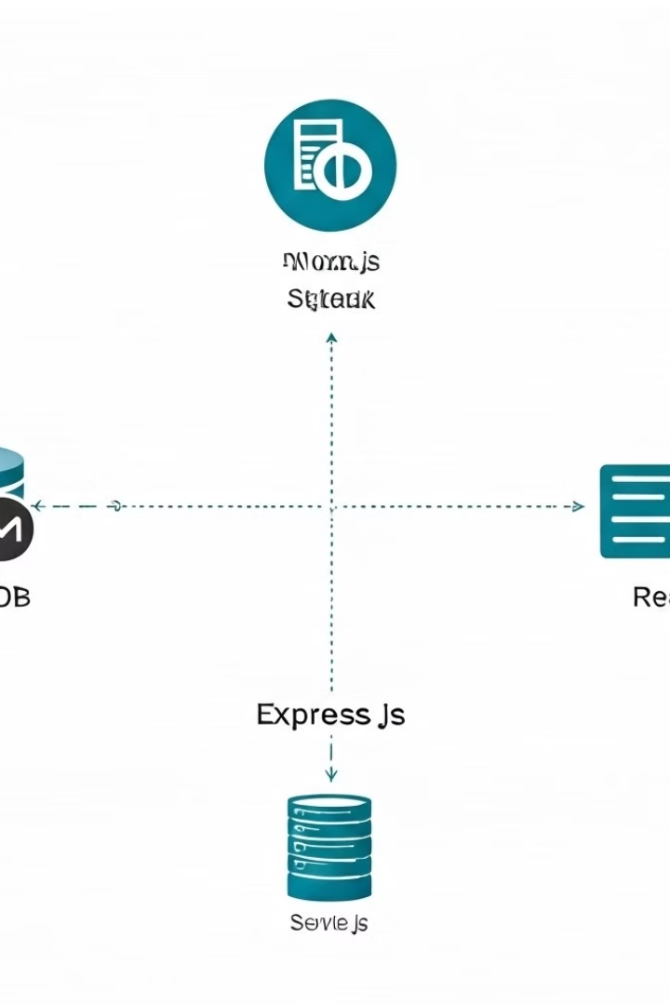
What is MERN Stack?
1
MongoDB
2
Express.js
A flexible and scalable NoSQL database that provides efficient data storage and retrieval for your freelance application.
A fast and minimalist web application framework for Node.js that simplifies the creation of server-side logic and APIs.
3
React.js
4
Node.js
A powerful JavaScript library for building user interfaces, enabling you to create dynamic and responsive freelance platforms.
A runtime environment that allows you to run JavaScript on the server, powering the backend of your freelance application.

Slide 3
Benefits of Freelancing with MERN Stack
Scalability
Flexibility
Cost-Effectiveness
The MERN stack's modular design and seamless integration between its components allow for easy scaling, ensuring your freelance platform can handle growing user demands and evolving business requirements.
The MERN stack's versatility enables you to customize your freelance application to meet the unique needs of your target market, whether that's specialized features, integrations, or user experiences.
With the MERN stack's open-source nature and the abundance of community-driven resources, you can build and maintain your freelance platform in a cost-effective manner, maximizing your return on investment.

Slide 4
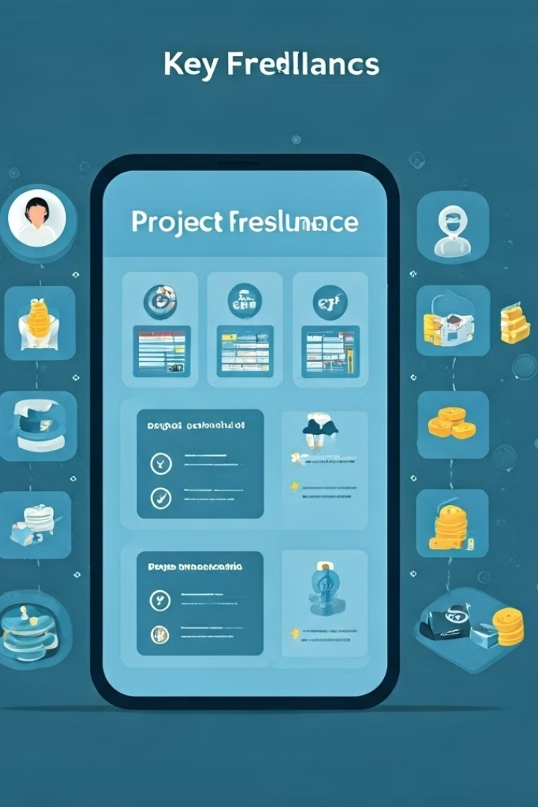
Key Features of the Freelancing Application
User Profiles
Project Posting
Freelancers can create comprehensive profiles that showcase their skills, experience, and portfolio, making it easier for clients to find and hire the right talent.
Clients can easily post project details, including scope, timeline, and budget, allowing freelancers to browse and bid on the opportunities that best fit their expertise.
Bidding and Proposals
Secure Payments
Freelancers can submit tailored proposals, highlighting their unique qualifications and approach, increasing their chances of being selected for the project.
The platform facilitates secure and transparent payment processing, ensuring both clients and freelancers can transact with confidence and peace of mind.

Slide 5
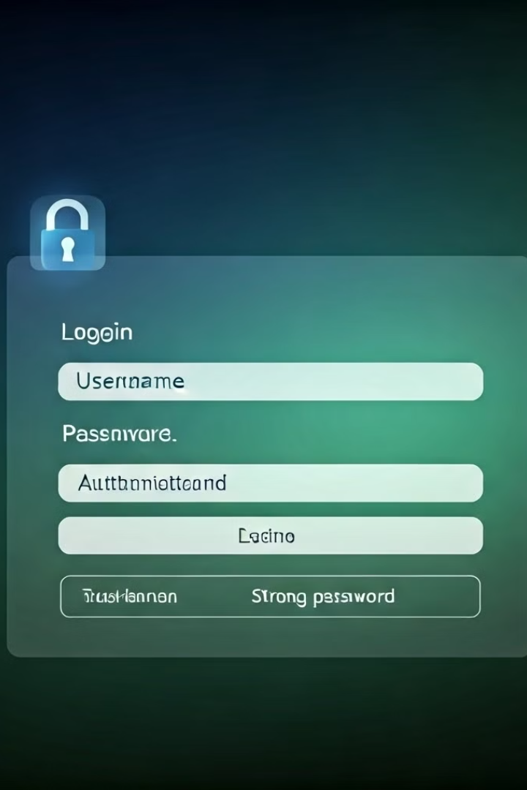
User Registration and Authentication
1
Sign Up
Users can easily register on the platform, providing essential information such as their name, email, and password to create a secure account.
2
Social Login
The application supports social media login options, allowing users to quickly and conveniently access the platform using their existing social media credentials.
3
Two-Factor Authentication
An additional layer of security is implemented through two-factor authentication, ensuring that only authorized users can access sensitive account information and features.

Slide 6
Creating Freelance Profiles and Portfolios
Profile Building
Portfolio Showcase
Dynamic Updates
Freelancers can create comprehensive profiles that highlight their expertise, qualifications, and past work experience, helping them stand out in a competitive market.
The platform provides a dedicated space for freelancers to showcase their work samples, case studies, and testimonials, giving clients a clear understanding of their capabilities.
Freelancers can easily update their profiles and portfolios as they acquire new skills, complete projects, or receive positive client reviews, ensuring their information remains current and relevant.

Slide 7
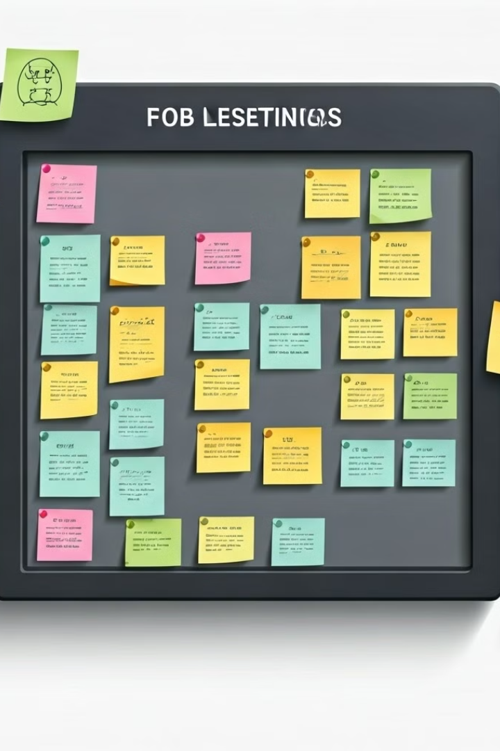



Posting and Bidding on Projects
Project Posting
Clients can post detailed job listings, including project scope, requirements, budget, and timeline, allowing freelancers to browse and apply for the opportunities that match their expertise.
Bidding Process
Freelancers can review project details and submit tailored proposals, highlighting their unique qualifications, approach, and timeline, increasing their chances of being selected for the job.
Offer and Acceptance
Clients can review freelancer proposals, engage in negotiations, and ultimately select the best candidate for the project, initiating the contract and payment process.

Slide 8




Secure Payments and Invoicing
Payment Processing
The platform offers seamless and secure payment processing, allowing clients to pay freelancers through various methods, such as credit cards, digital wallets, or bank transfers.
Invoicing
Freelancers can generate professional invoices directly within the platform, streamlining the billing process and ensuring timely and accurate payments.
Escrow Services
The platform may provide escrow services to hold client payments in trust until project milestones are successfully completed, protecting both parties and promoting trust in the freelance relationship.

Slide 9

Conclusion and Future Enhancements
The MERN stack-based freelance application presented in this introduction offers a comprehensive and secure platform for both freelancers and clients to connect, collaborate, and succeed in the ever-evolving gig economy. As the platform continues to evolve, future enhancements may include AI-powered job recommendations, virtual collaboration tools, advanced data analytics, and integration with a wider ecosystem of third-party services to provide an even more seamless and efficient freelancing experience.

